Slide 1

Master’s thesis: Real-time signal synchronisation with acoustic fingerprinting
Ward Van Assche
Student information engineering technology
UGent
27 may 2016

Slide 2
Demonstration: prelude
2 wave files
To each file: added several moments of silence
Audio is shifted to the right
After each silence: latency changed
Duration of waveforms (on next slide): 90 seconds

Slide 3
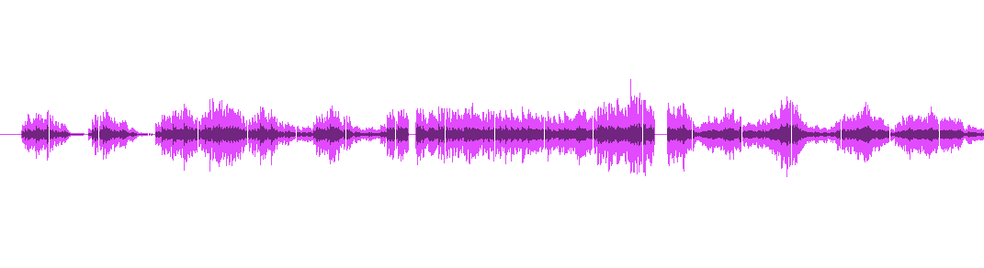
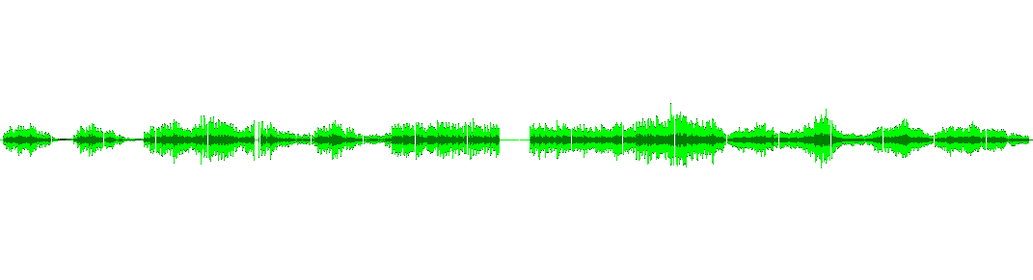
Demonstration: silences
1,870s
0.8s
1.3s
1,732s
0.544s
0.300s
3.0s
0.5s

Slide 4
Demonstration
Max/MSP module:
Input: signals from wavefiles
Output: synchronized signals
Synchronization:
No extra timing information
Only by using audio features
First audiosignal: left speaker
Second audiosignal: right speaker

Slide 5
Note
Any latency change can be detected
(The algorithms do not just look for silence)
The audiostreams do not have to be exactly the same
(This system also works with different recorded audiostreams)

Slide 6
Why is it useful?
IPEM experiments
Audio
Video
Sensors
...
Problem: latency
Synchronisation: necessary

Slide 7
The solution
Attach each sensor to a microphone
Microphone: records environment sound
Latency recorded sound = latency sensordata
Much easier to detect:
Recorded environment sound: almost the same for each recording

Slide 8
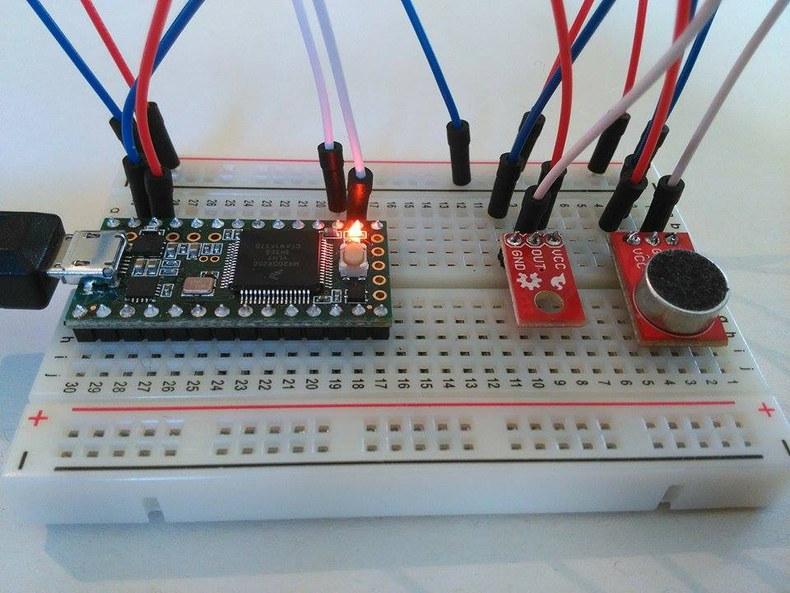
Attaching sensor to microphone
Teensy microcontroller
Microphone
Sensor

Slide 9
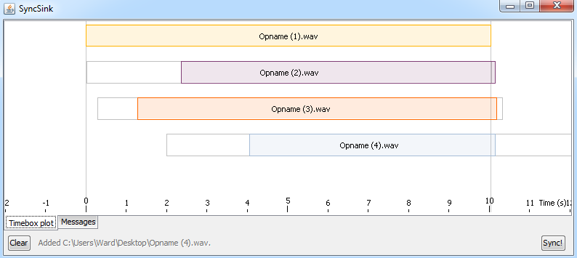
What about SyncSink? [2]

Slide 10
What about SyncSink? [2]
SyncSink:
Executed after the experiment
Desirable:
Real-time synchronisation
A more user-friendly system (like a Max/MSP module)

Slide 11
How does it work?
Acoustic fingerprinting [1]
Determining fingerprints of audio clip
Based on spectral peaks:
Generate spectrogram
Find peaks
Create fingerprints

Slide 12
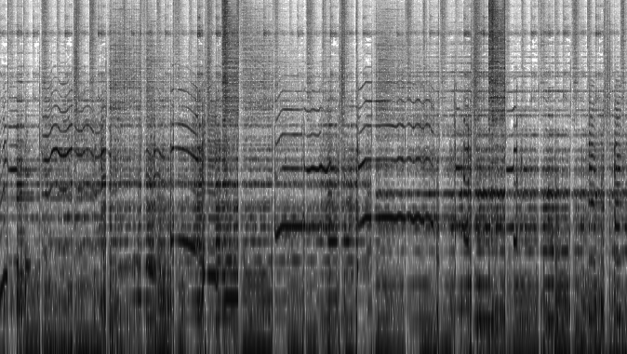
The spectrogram
frequency
time

Slide 13
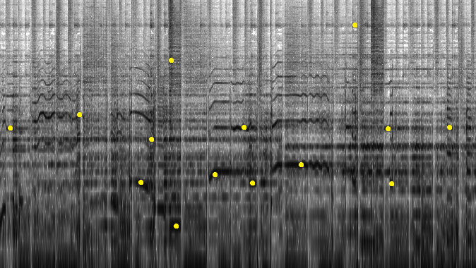
Extraction of spectral peaks
frequency
time

Slide 14
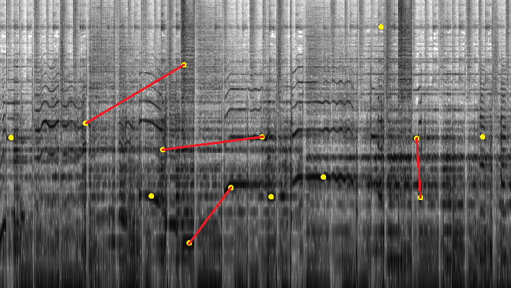
Creation of the fingerprints
frequency
time

Slide 15
Acoustic fingerprinting [1]
Detecting the latency:
Each fingerprint contains timing information
Find matching fingerprints
Latency = difference between time of fingerprints
Accuracy: default 32ms
Not sufficient

Slide 16
Another technique: cross-covariance [2]
Cross-covariance: degree of similarity between two signals
Calculate for each shift
Shift with highest crosscovariance value: latency
Very accurate: < 1ms
Pitfall: SLOW
First acoustic fingerprinting
Refine result with this technique

Slide 17
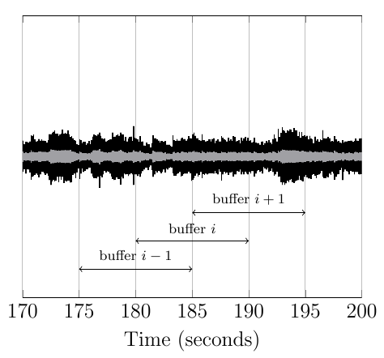
Real-time: impossible
Algorithms: need audio to analyze
Real-time streams: buffered

Slide 18
Buffering of streams
Algorithms: executed on the consecutive buffers of each stream
After determining latency:
Adding silence to audiostreams + attached datastreams
Streams: synchronized

Slide 19
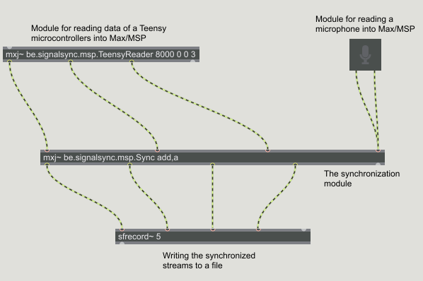
The Max/MSP modules
Notes:
Input van microfoon

Slide 20
Soort van conclusie, herhalen van introductie, wat er precies allemaal gedaan is en wat het nut er van is.

Slide 21
Future improvements
Synchronization currently only possible with Max/MSP signals
Impossible: synchronization of video or MIDI streams:
Should be converted to a Max/MSP signal.

Slide 22
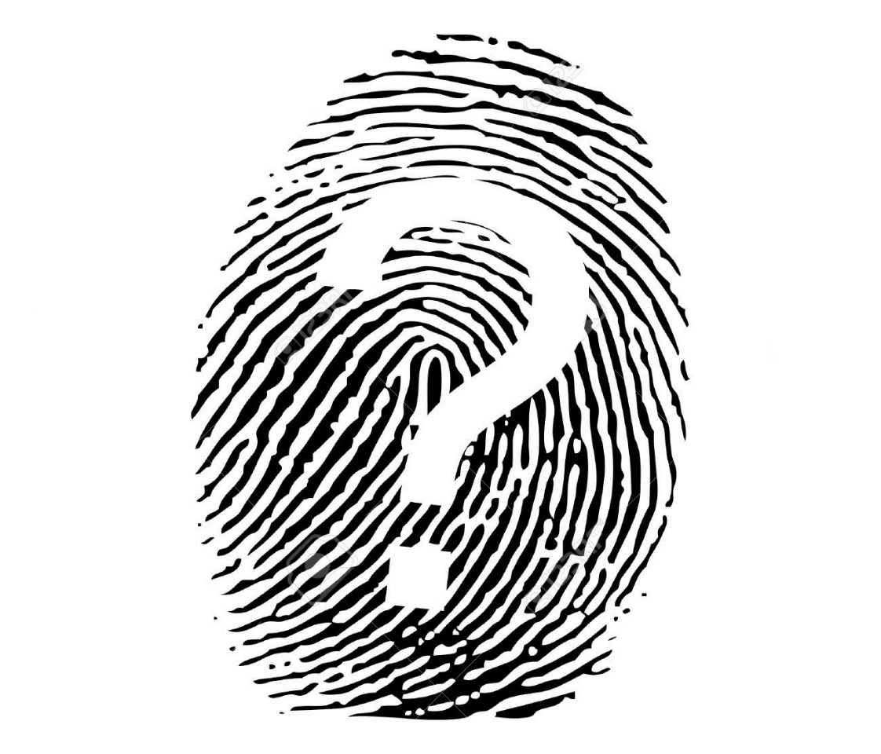
Questions?

Slide 23
References
[1] Avery L. Wang. An Industrial-Strength Audio Search Algorithm. In Proceedings of the 4th International Symposium on Music Information Retrieval (ISMIR 2003), pages 7–13, 2003.
[2] Joren Six and Marc Leman. Synchronizing Multimodal Recordings Using Audio-To-Audio Alignment. Journal of Multimodal User Interfaces
[3] Joren Six and Marc Leman. Panako - A Scalable Acoustic Fingerprinting System Handling Time-Scale and Pitch Modification. In Proceedings of the 15th ISMIR Conference (ISMIR 2014), 2014.

